Slide 1
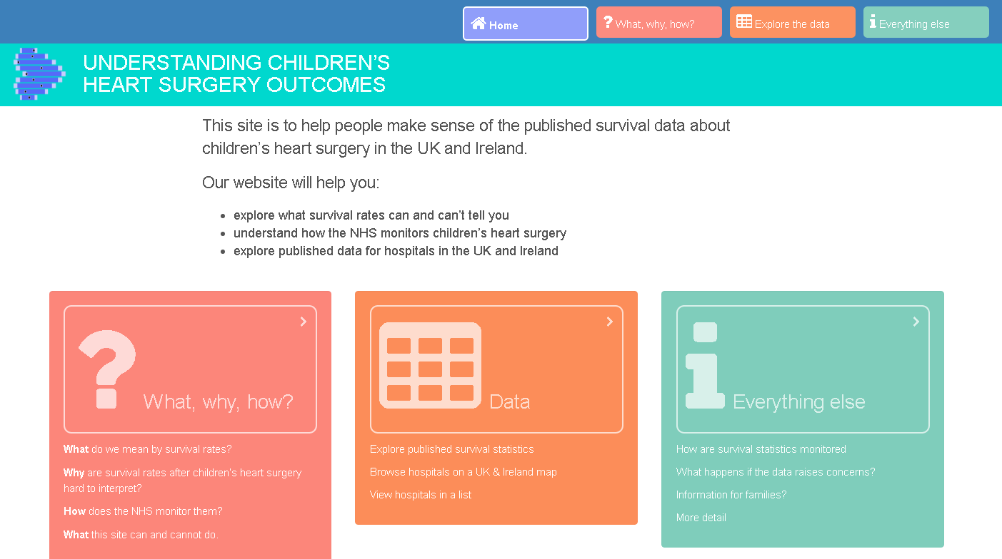
UNDERSTANDNG CHILDREN’S
HEART SURGERY OUTCOMES

Slide 2
UNDERSTANDNG CHILDREN’S
HEART SURGERY OUTCOMES

Slide 3
UNDERSTANDNG CHILDREN’S
HEART SURGERY OUTCOMES

Slide 4
UNDERSTANDNG CHILDREN’S
HEART SURGERY OUTCOMES

Slide 5
UNDERSTANDNG CHILDREN’S
HEART SURGERY OUTCOMES

